Slide 1


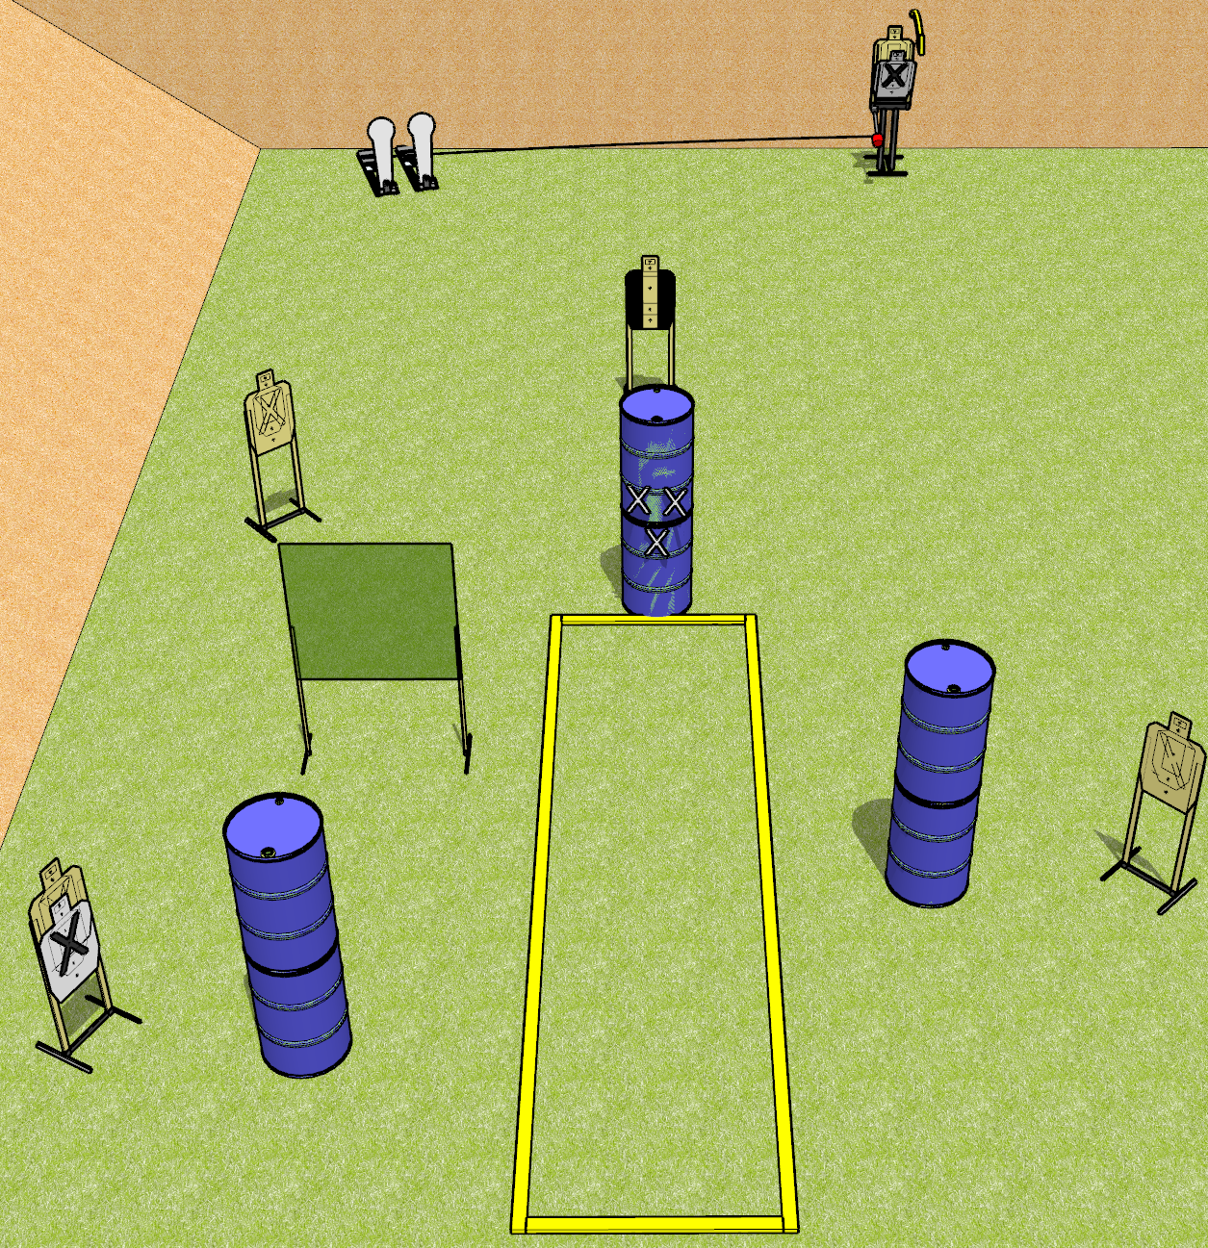
 | Dothan Gun Club – USPSA Match Back it Up Course Designer : Drew Coleman
START POSITION : Standing behind barrel with marks on it, fingers touching marks.
GUN READY CONDITION : Pistol loaded and holstered. PCC loaded, held with both hands, shouldered, safety on, muzzle touching a mark. |  | SCORING: Comstock, 12 rounds TARGETS: 5 paper, 2 Steel SCORED HITS: Best 2 on paper, steel until down START-STOP: Audible, last shot RULES:
STAGE PROCEDURE: Engage targets as they become available from within the fault lines.

Slide 2
Back it Up
Written Stage Briefing
Back it Up is a 12 round, 60 point, Comstock short course. There are five USPSA targets and two Colt poppers. The best two hits on paper will score, and steel must fall to score. The start signal is audible.
Either popper will activate the Max Trap. The Max Trap is not a disappearing target. Please check the activators before walkthrough and set them the same way every time.
Handgun start position is standing behind barrel with marks on it with fingers touching upper set of marks. Handgun is loaded and holstered.
PCC start position is standing behind barrel with marks on it, muzzle touching any mark. Loaded carbine is held with both hands, safety on, shouldered.
On start signal, engage targets as they become available from within the shooting area.

Slide 3
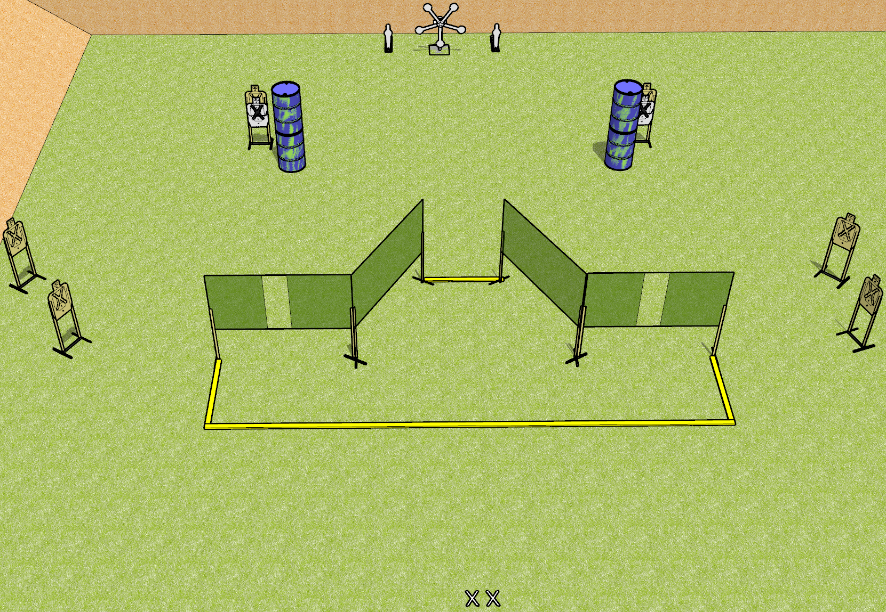
 | Dothan Gun Club – USPSA Match Star Power Course Designer : Drew Coleman
START POSITION : Standing with both feet on X’s, wrists below belt
GUN READY CONDITION : Pistol loaded and holstered. PCC loaded, held with both hands, shouldered, safety on. |  | SCORING: Comstock, 19 rounds TARGETS: 6 paper, 7 Steel SCORED HITS: Best 2 on paper, steel until down START-STOP: Audible, last shot RULES:
STAGE PROCEDURE: Engage targets as they become available from within the fault lines.

Slide 4
Star Power
Written Stage Briefing
Star Power is a 19 round, 95 point, Comstock field course. There are six USPSA targets, two mini poppers, and five falling plates. The best two hits on paper will score and steel must fall to score. The start signal is audible.
Handgun start position is standing with both feet on X’s, wrists below belt. Handgun is loaded and holstered.
PCC start position is standing with both feet on X’s. Loaded carbine is held with both hands, safety on, shouldered.
On start signal, engage targets as they become available from within the shooting area.

Slide 5
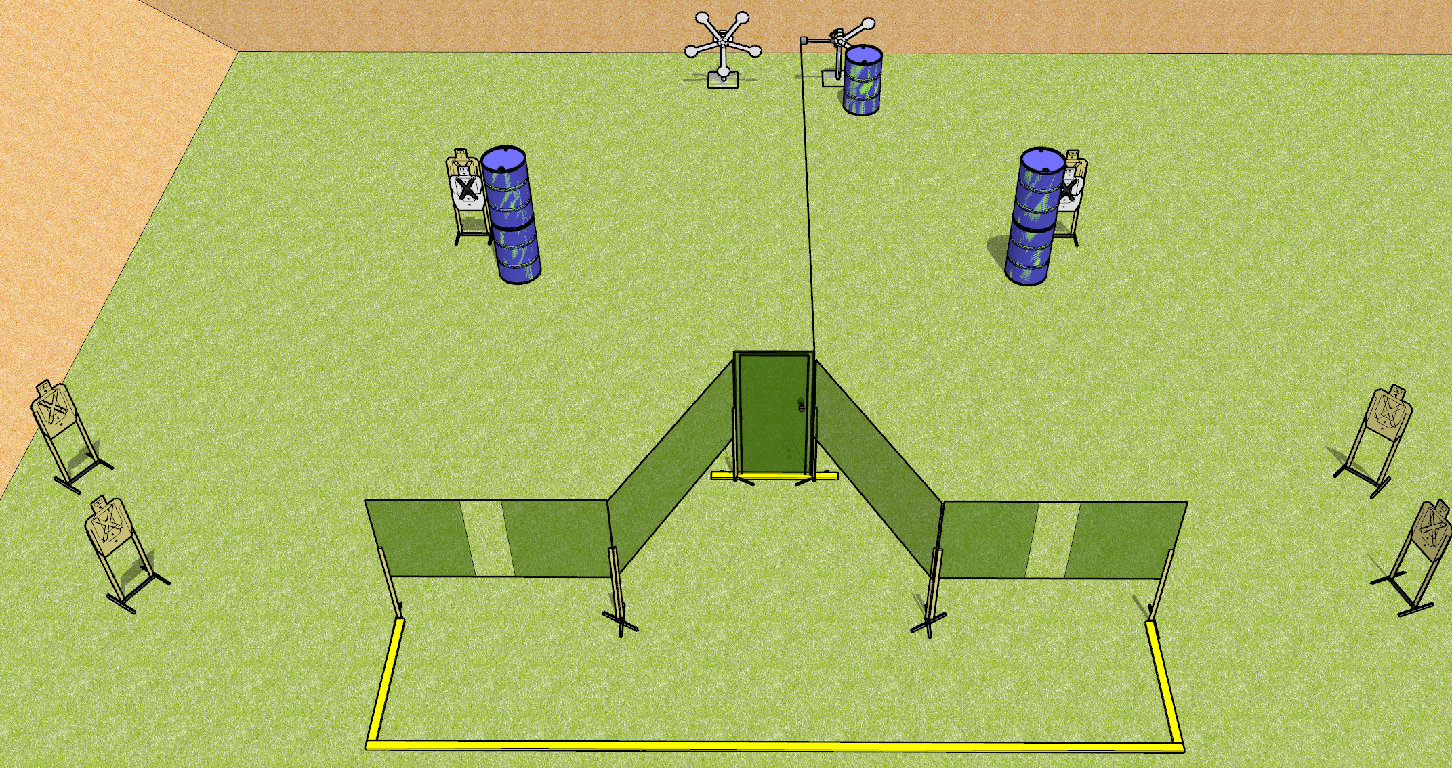
 | Dothan Gun Club – USPSA Match Star Power Course Designer : Drew Coleman
START POSITION : Standing with either hand touching doorknob, other hand wrist below belt. PCC buttstock on belt, muzzle touching doorknob.
GUN READY CONDITION : Pistol loaded and holstered. PCC loaded, held with both hands, shouldered, safety on. |  | SCORING: Comstock, 19 rounds TARGETS: 6 paper, 7 Steel SCORED HITS: Best 2 on paper, steel until down START-STOP: Audible, last shot RULES:
STAGE PROCEDURE: Engage targets as they become available from within the fault lines.

Slide 6
Star Power
Written Stage Briefing
Star Power is a 19 round, 95 point, Comstock medium course. There are six USPSA targets and seven falling steel. The best two hits on paper will score, and steel must fall to score. The start signal is audible.
The swinging steel target is activated by the door. It must be activated before being engaged. Please check the activator prior to walkthrough and set it the same way every time.
Handgun start position is standing with either hand touching the door handle, other hand wrist below belt. Handgun is loaded and holstered.
PCC start position is standing with muzzle touching door handle. Loaded carbine is held with both hands, safety on, shouldered.
On start signal, engage targets as they become available from within the shooting area.

Slide 7
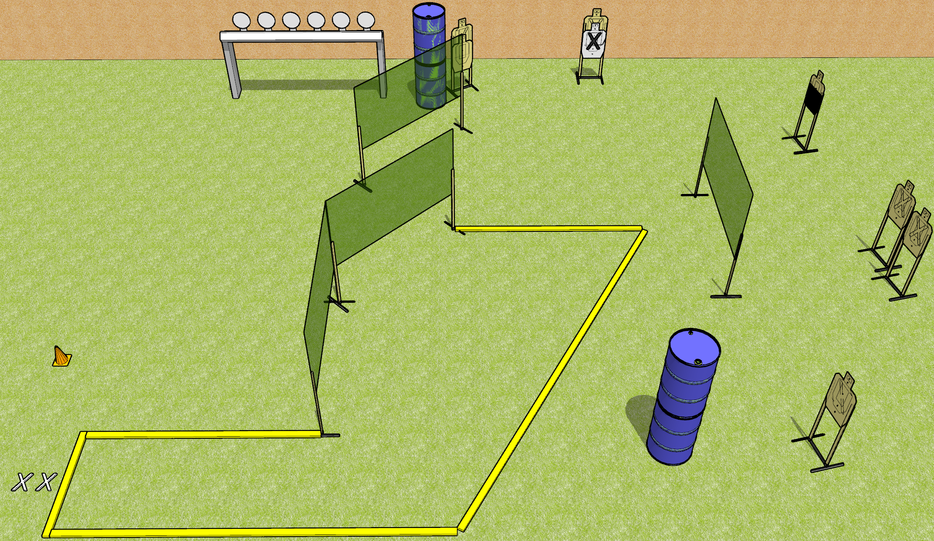
 | Dothan Gun Club – USPSA Match Get that Plate Rack Course Designer : Drew Coleman
START POSITION : Standing with both feet on X’s, wrists below belt
GUN READY CONDITION : Pistol loaded and holstered. PCC loaded, held with both hands, shouldered, safety on, pointed at orange cone. |  | SCORING: Comstock, 20 rounds TARGETS: 7 paper, 6 Steel SCORED HITS: Best 2 on paper, steel until down START-STOP: Audible, last shot RULES:
STAGE PROCEDURE: Engage targets as they become available from within the fault lines.

Slide 8
Get that Plate Rack
Written Stage Briefing
Get that Plate Rack is a 20 round, 100 point, Comstock medium course. There are seven USPSA targets and six falling plates. The best two hits on paper will score, and steel must fall to score. The start signal is audible.
Handgun start position is standing with both feet on X’s, wrists below belt. Pistol is loaded and holstered.
PCC start position is standing with both feet on X’s, muzzle pointed at orange cone. Loaded carbine is held with both hands, shouldered, safety on.
On start signal, engage targets as they become available from within the shooting area.

Slide 9
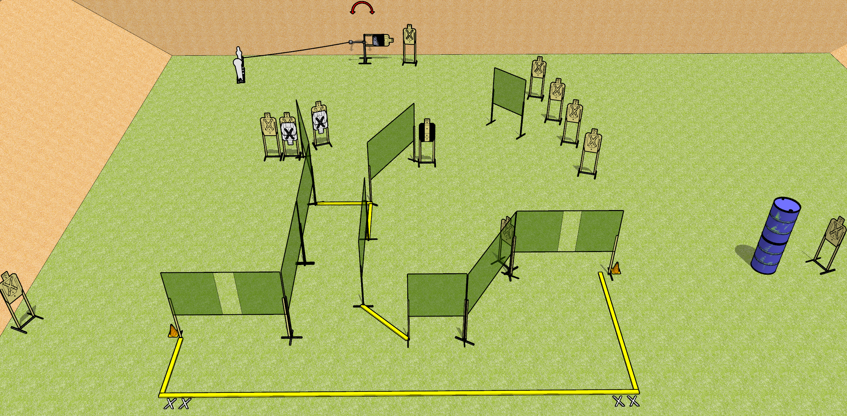
 | Dothan Gun Club – USPSA Match Getting Around Course Designer : Drew Coleman
START POSITION : Standing with both feet on either set of X’s, wrists below belt
GUN READY CONDITION : Pistol loaded and holstered. PCC loaded, held with both hands, shouldered, safety on, pointed at orange cone. |  | SCORING: Comstock, 28 rounds TARGETS: 13 paper, 2 Steel SCORED HITS: Best 2 on paper, steel until down START-STOP: Audible, last shot RULES:
STAGE PROCEDURE: Engage targets as they become available from within the fault lines.

Slide 10
Getting Around
Written Stage Briefing
Getting Around is a 28 round, 140 point, Comstock field course. There are thirteen USPSA targets, one colt popper, and one mini popper. The best two hits on paper will score and steel must fall to score. The start signal is audible.
The mini popper will activate the swinger. Please check to see how the activator is set before walkthrough and set it the same way every time.
Handgun start position is standing with both feet on either set of X’s, wrists below belt. Handgun is loaded and holstered.
PCC start position is standing with both feet on either set of X’s, muzzle pointed at either orange cone. Loaded carbine is held with both hands, shouldered, safety on.
On start signal, engage targets as they become available from within the shooting area.

Slide 11
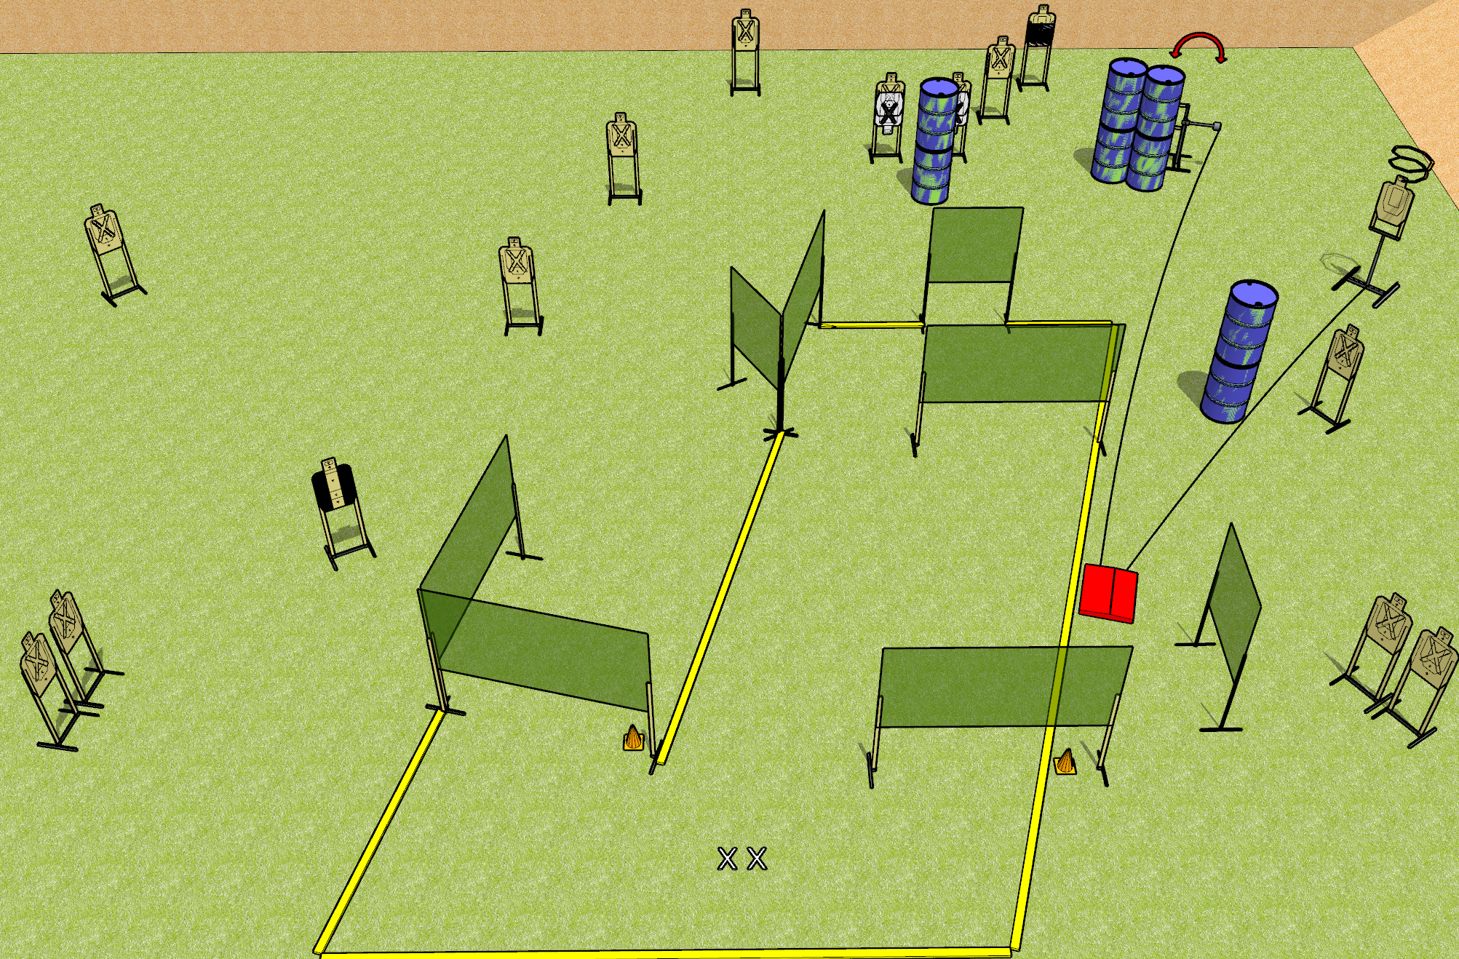
 | Dothan Gun Club – USPSA Match I Got Nothing Course Designer : Drew Coleman
START POSITION : Standing with both feet on X’s, wrists below belt
GUN READY CONDITION : Pistol loaded and holstered. PCC loaded, held with both hands, shouldered, safety on, pointed at orange cone. |  | SCORING: Comstock, 32 rounds TARGETS: 16 paper, 0 Steel SCORED HITS: Best 2 on paper, steel until down START-STOP: Audible, last shot RULES: Drop turner is a disappearing target
STAGE PROCEDURE: Engage targets as they become available from within the fault lines.

Slide 12
I Got Nothing
Written Stage Briefing
I Got Nothing is a 32 round, 160 point, Comstock field course. There are sixteen USPSA targets. The best two hits on paper will score. The start signal is audible.
The drop turner and swinger are both activated by the stomp pad. The drop turner is a disappearing target, and the swinger is visible at rest. Please check the activators before walkthrough and set them the same way every time.
Handgun start position is standing with both feet on X’s, wrists below belt. Handgun is loaded and holstered.
PCC start position is standing with both feet on X’s, muzzle pointed at orange cone. Loaded carbine is held with both hands, safety on, shouldered.
On start signal engage targets as they become available from within the shooting area.

Slide 13
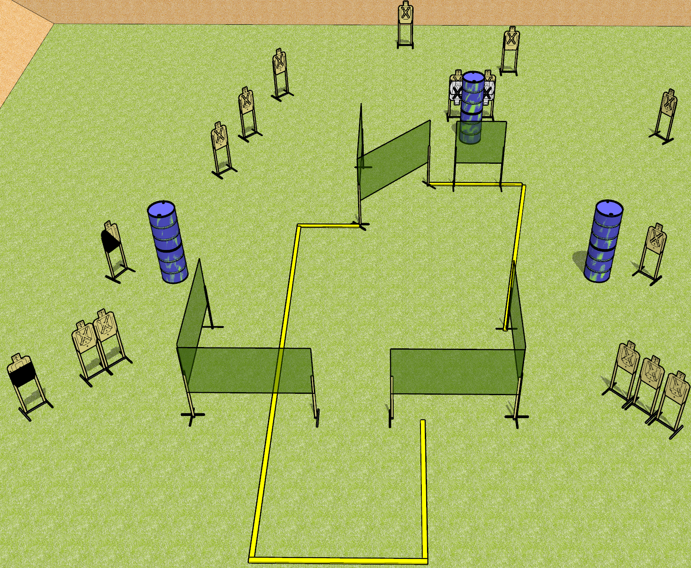
 | Dothan Gun Club – USPSA Match So Much To Do Course Designer : Drew Coleman
START POSITION : Standing anywhere outside the shooting are, wrists below belt
GUN READY CONDITION : Pistol loaded and holstered. PCC loaded, held with both hands, buttstock on belt, safety on. |  | SCORING: Comstock, 32 rounds TARGETS: 16 paper, 0 Steel SCORED HITS: Best 2 on paper, steel until down START-STOP: Audible, last shot RULES:
STAGE PROCEDURE: Engage targets as they become available from within the fault lines.

Slide 14
So Much To Do
Written Stage Briefing
So Much To Do is a 32 round, 160 point, Comstock field course. There are sixteen USPSA targets. The best two hits on paper will score. The start signal is audible.
Handgun start position is standing anywhere outside the shooting area, wrists below belt. Handgun is loaded and holstered.
PCC start position is standing anywhere outside the shooting area. Loaded carbine is held with both hands, safety on, buttstock on belt.
On start signal, engage targets as they become available from within the shooting area.

